Slide 1
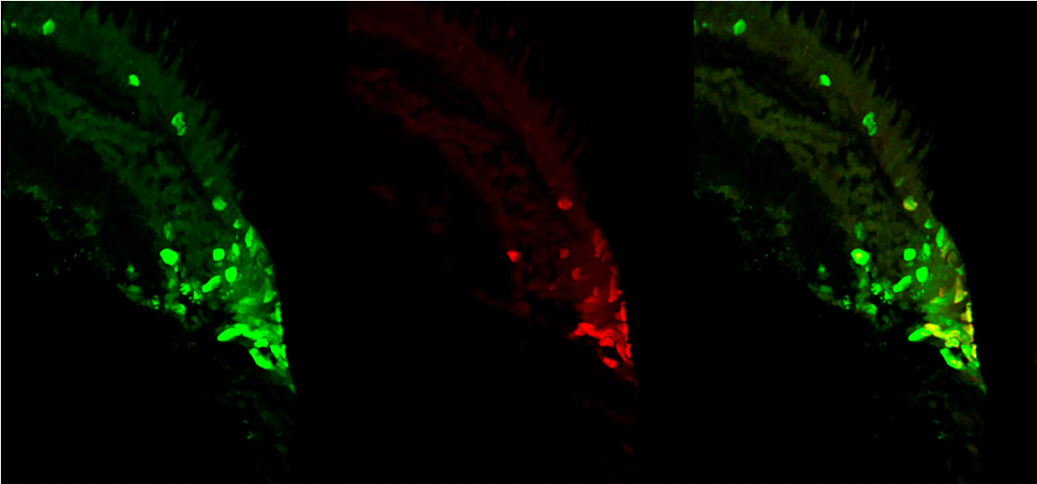
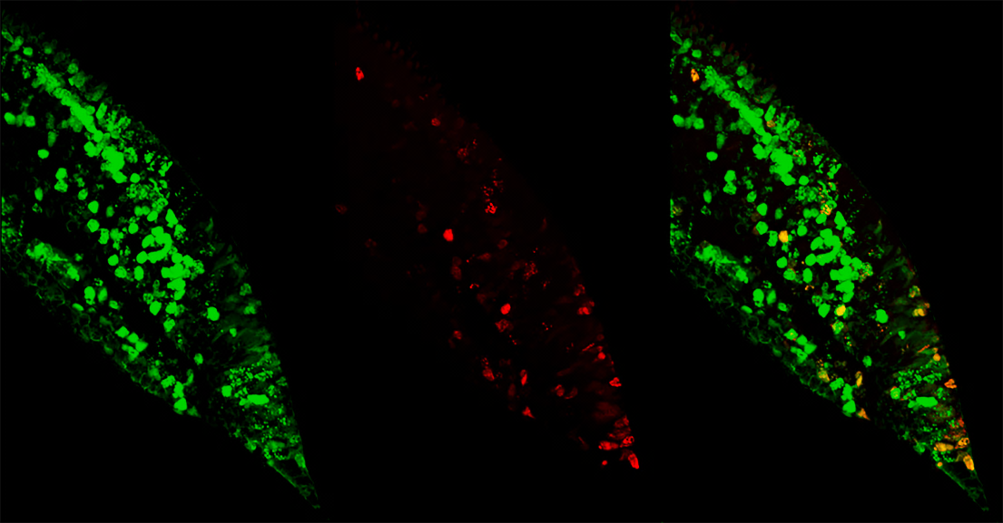
Figure 8
A
ONL
INL
GCL
IdU
CldU
IdU/CldU
Lightt
CMZ
B
ONL
INL
GCL
Darkness
CMZ
C
Quantitation throughout the retina

